Slide 1

Secret Code Guessing
Juni Ejere
StMU CS2315 Fall, 2022

Slide 2

Introduction(1)
User must understand what binary digits are.
Binary code is the most simplistic form of data. It is represented entirely by a binary system of digits consisting of a string of consecutive zeros and ones.
A bit (short for "binary digit") is the smallest unit of measurement used to quantify computer data. It contains a single binary value of 0 or 1.
Bits can also represent truth values, where 0 is false and 1 is true.
Sources:
www.techopedia.com/definition/17052/binary-code
Bit Definition (techterms.com)

Slide 3
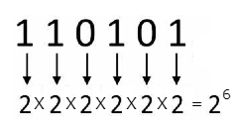
Introduction(2)
The next thing to note about this program is how the number of possible codes increases with the size of the bit string.
For the size of the string n, there are 2^n codes that the user could choose.
The picture below demonstrates the number of combinations if n = 6.
There are 64 possible combinations for n = 6.

Slide 4
Problem Statement
(From pg. 47 of Levitin and Levitin. Algorithmic Puzzles (C). Oxford University Press, 2011.)
(1) Have the user input an integer n which will serve as the size for a string of bits (Ex. 11011 for n = 5). Refer to this as a “code.”
(2) Tell the user to think of their secret code.
(3) Provide “guesses” of the code by outputting n-bit strings to the user
(4) For each guess, have the user input how many bits in the guess coincide with the corresponding bits in the secret code ( Ex. Secret Code = 01011; Guess = 11001; User will input 3 because the two strings have the same bits in the second, third, and fifth positions. )
(5) You should be able to guess any secret n-bit code in no more than n questions.

Slide 5
Important Picture(1)
User’s Code (n = 5) | Program Guess | Position tested | Test number of positions correct
11001 | 01000 | (First guess) | 3
 | 00111 | 1st | 1
 | 11111 * | 2nd | 3
 | 10011 * | 3rd | 3
 | 10101 * | 4th | 3
 | 10110 | 5th | 1
Formula: Test positions correct = n – (positions correct first guess) + 1
Formula Applied: Test positions correct = 5 – 3 + 1 = 3
* = correct spot

Slide 6
Important Picture(2)
User’s Code (n = 5) | Program Guess | Position tested | Test number of positions correct
00110 | 11000 | (First guess) | 1
 | 10111 | 1st | 2
 | 01111 | 2nd | 3
 | 00011 | 3rd | 3
 | 00101 | 4th | 3
 | 00110 * | 5th | 5
Formula: Test positions correct = n – (positions correct first guess) + 1
Formula Applied: Test positions correct = 5 – 1 + 1 = 5
* = correct position

Slide 7
Important Picture(3)
User’s Code (n = 3) | Program Guess | Position tested | Test number of positions correct
001 | 000 | (First guess) | 2
 | 001 * | 1st | 2
 | 101 * | 2nd | 2
 | 110 | 3rd | 0
Formula: Test positions correct = n – (positions correct first guess) + 1
Formula Applied: Test positions correct = 3 – 2 + 1 = 2
* = correct spot

Slide 8

Important Algorithm
This algorithm is used to identify the correct spots based on the formula
Create first guess
Receive the number of positions correct from the user and save
For each spot in the string and while correct spots are not found and while incorrect spots are not found
For each spot not being tested
Flip the bit
Output guess for the spot being tested
If the new number of positions correct is equal to the formula
Save the spot as a correct spot
Else
Save the spot as an incorrect spot
The first loop will terminate once either all the correct spots are found, all the incorrect spots are found, or the program runs out of guesses

Slide 9
Formula Explained
As demonstrated in the “Important Picture” slides, there is a formula to determine if a spot is in the user’s secret code
After the first guess is outputted and the number of positions correct are received, the next step is to test each spot and determine if it is one of the number of positions correct.
Testing each spot consists of keeping its value the same and flipping every other value in the string.
While testing a spot, if it is in the secret code the number of correct positions will be as follows:
n – (number of positions correct first guess) + 1

Slide 10
Computational and Critical Thinking Question
int spot = 1;
int correctCount = 0;
int notCorrectCount = 0;
while(spot <= n && notCorrectCount != (n-positions) && correctCount != positions)
{
-----
spot++
}
The above code is a sneak peek of the while loop used to iterate through each spot, but stops early if all the correct spots are found or all the incorrect spots are found.
( Remember that for a spot to be considered correct, when it is tested the number of positions correct must be equal to the formula given. )
a. How do we know that all the correct spots are found if it is equal to positions?
b. How do we know that all the incorrect spots are found if it is equal to n-positions?
c. How come we are saving both the number of correct spots and the number of incorrect spots with each iteration, and not just one?

Slide 11
Answer
The variable positions holds the number of spots that were correct for the first guess. If correctCount reaches this number, then that means all the spots that were correct in the first guess have been found.
b. The variable positions holds the number of spots that were correct for the first guess. That means that the number of incorrect spots will be the total number of spots minus those that were correct, or (n-positions).
c. This ensures that the user's secret code is found within n guesses. If we chose to just iterate through every spot, then we would have n+1 total guesses, which would be the first guess plus the tester guess for each n spot. If we chose just to count the correct spots and terminate the loop when they are all found, there is a possibility that all the correct spots are at the end of the code, so they wouldn't be found until every spot is checked, leaving us with n+1 total guesses again. By choosing to also count the incorrect spots, it accounts for scenarios where the correct spots may be hiding at the end of the code as well. When all the incorrect spots are found, we know that the spots remaining must be in the secret code.

Slide 12
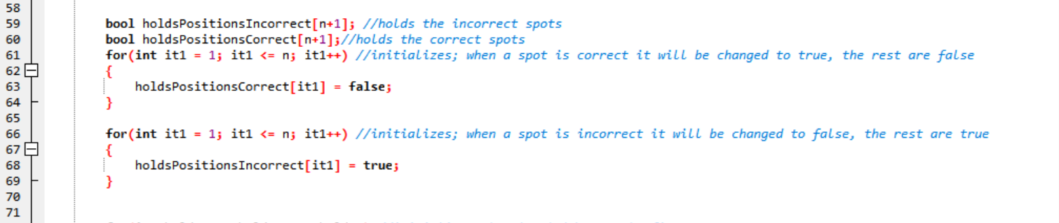
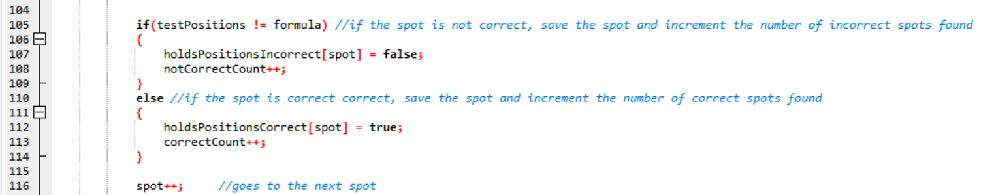
Important Code(1)

Slide 13
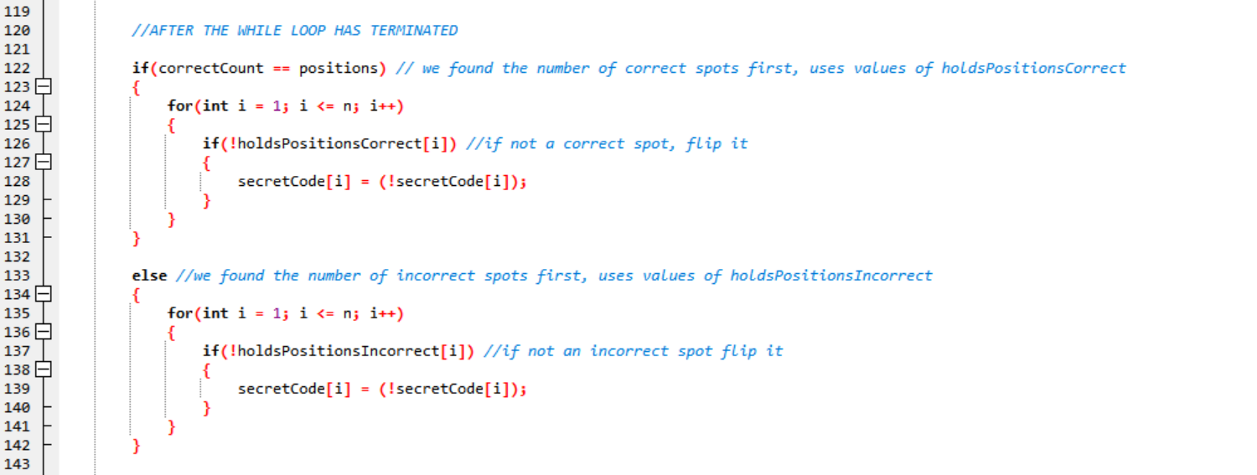
Important Code(2)

Slide 14
Important Code (Explanation)
There are two main arrays used to hold the correct and incorrect positions
holdsPositionsCorrect stores the correct values
holdsPositionsIncorrect stores the incorrect values
Both of them are boolean arrays and in both arrays each spot will hold a value of 1 if it is in the secret code, and 0 if it is not.
That means holdsPositionsCorrect must be initialized so that every spot is false.
Every time a correct spot is found, that position in the array will be changed to true.
If all the correct spots are found first, then by default, the remainders will be false.
It is the opposite for holdsPositionsIncorrect, which is initialized to all true.
If all the incorrect spots are found first and the while loop terminates, then those spots will hold a value of false, while the remainder are true.
After the while loop has terminated, the next step is to determine if all the correct spots or all the incorrect spots were found first.
This affects whether the holdsPositionsCorrect or holdsPositionsIncorrect array is used
For either array, when iterating through each spot, if the value is false, then the value in the secret code array will be flipped.
This leaves our secret code array with the correct spots having the same value as they did in the first guess, and every other spot flipped

Slide 15

Lessons Learned
Simpler is better!
I originally tried to solve this problem with combinations. I would use the size of the array as n, and the number of positions correct as my k in the formula: n!/k!(n-k)!
To try to narrow down the number of possible combinations that the user was using. The problem I had here was that trying to test 2, 3, 4, etc. positions at a time made it much more difficult to determine which spots were actually in the secret code.
By choosing to test each position 1 at a time, a pattern arose and that is when the formula to determine if a spot was correct:
test number of positions correct = n-positions + 1
was found.

Slide 16

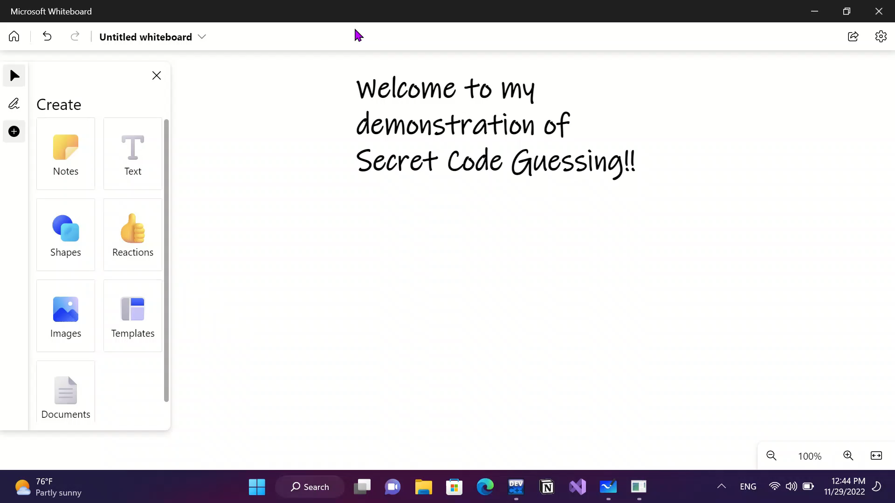
Demonstration

Slide 17

Questions?

